Slide 1
Controllers and the GST Site Foundation
April 29, 2011
Tony Field
Global Solutions Architect
Tony.Field@fatwire.com
Notes:
1
Last Revision Date: 3/28/11 (Jenny Wongtangswad)

Slide 2
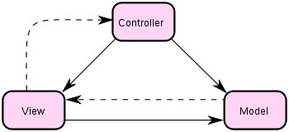
Model-view-controller and Content Server - Background
Design pattern that separates domain-specific data, business logic, and presentation layer.
Model – domain-specific data
View – Presentation layer
Controller – business logic
Background
In the JEE sense, Content Server is the controller
SiteCatalog and ElementCatalog entries make up the view
This leaves no room for developers to build controllers since CS is not modifiable
Most sites require a controller…

Slide 3
MVC and Content Server - Options
If CS is the controller and I need my own, what can I do?
Avoid using CS as rendering engine
forego all rendering performance benefits
forego Engage
CS access is restricted to Asset API & REST APIs only
Layer controller on top of CS
Requires some basic plumbing
Plays nicely with MVC patterns
Used widely by customers

Slide 4
XML Element Entry Point
Use the root element as part of the controller!
Create a special Content Server page that will act as a controller
pagename from URL must point to XML element to set HTTP headers
Multiple pagenames can be used for multiple controllers
Page name is often called “Wrapper” or “Dispatcher”.
From this element, call a Java class using <CALLJAVA>
Any class implementing Seed2 is applicable
Home-grown controller frameworks have evolved to plug into this
No direct integration with Spring MVC or Struts etc.

Slide 5
XML Element Entry Point Flow
Internet
Content Server still serves request
“page” dispatches back to Java
Business logic in Java
Java selects actual view
Dispatch to view for response
Cached views
Can only set parameters
Uncached views
Can set objects, lists, and parameters
Web Server
App Server
Content Server
Content Server Servlet
Dispatcher/Controller
Page (GST/Dispatcher)
Controller Java Seed (Extends AbstractController)
Your Rendering Template

Slide 6
MVC Implementations
Implementing Seed2 is trivial
GST Site Foundation (GSF) provides AbstractController
BaseController provides rendering
GSF version is live on several sites
Older implementations are widely used
ActionController implements command pattern
GSF version is in testing
Older implementations are live but less common
XMLMVC controller is SpringMVC-Like
Used by several customers including fatwire.com
No longer being developed
Others available in svn repository

Slide 7
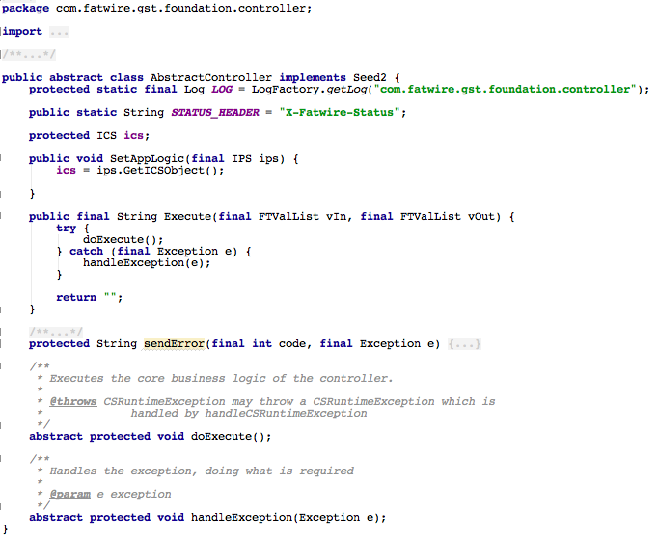
Code Snippets – Seed2 & AbstractController

Slide 8
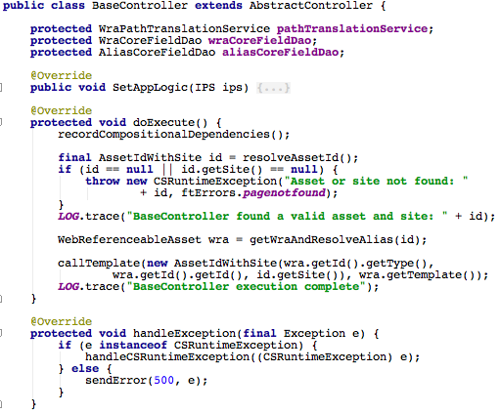
Code Snippets - BaseController

Slide 9
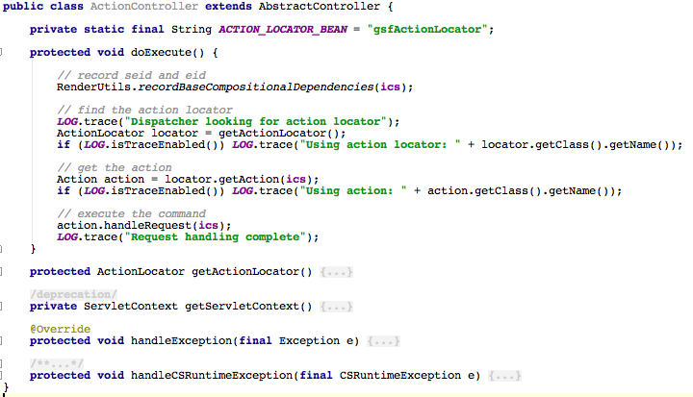
Code Snippets - ActionController

Slide 10
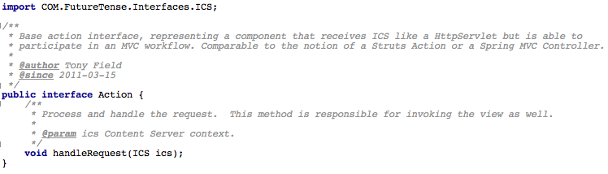
Code Snippets - Action

Slide 11
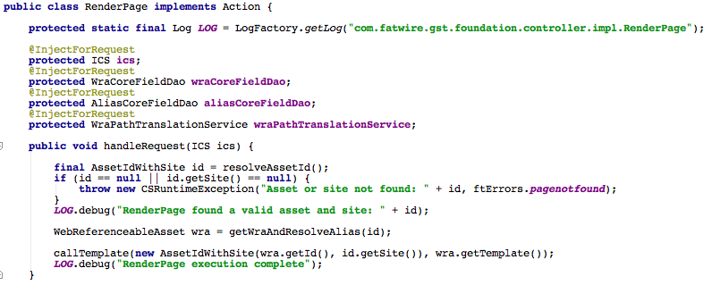
Code Snippets – RenderPage Action

Slide 12
Design Pattern – Web-Referenceable Asset
Web-Referenceable Assets are referred to by URL
Contain a pointer to their preferred view
The view (Template) drives the full layout of the page
WRA Templates are often synonymous with wireframes
WRAs often utilize other assets to decorate the view
Modules
Navigation
Supporting assets like Images, lists, and Recommendations
More
For more information, see the GST Site Foundation

Slide 13
Thank You!

